Slide 1
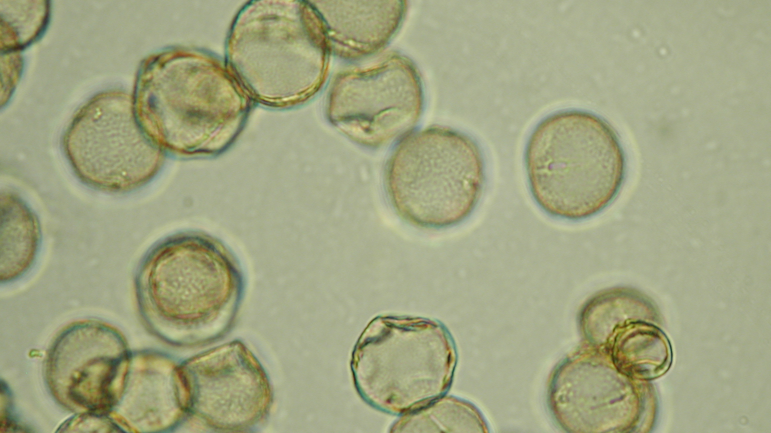



A Treescapes Curriculum: Activities for learning with local trees and woods
Pollen analysis: palynologist for the day
Grace Banks, Elizabeth Curtis, Ed Schofield, Colin Shepherd & Jo Vergunst
This resource is distributed under a Creative Commons licence CC BY-NC-ND.

Slide 2
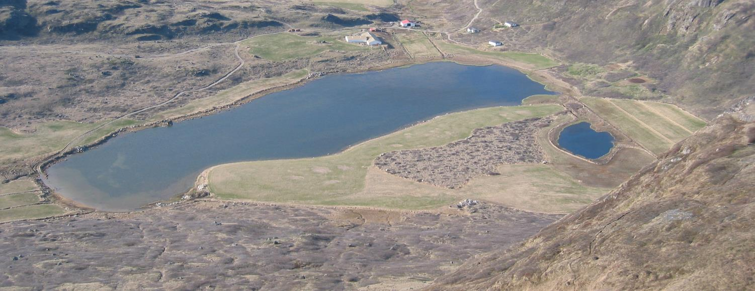
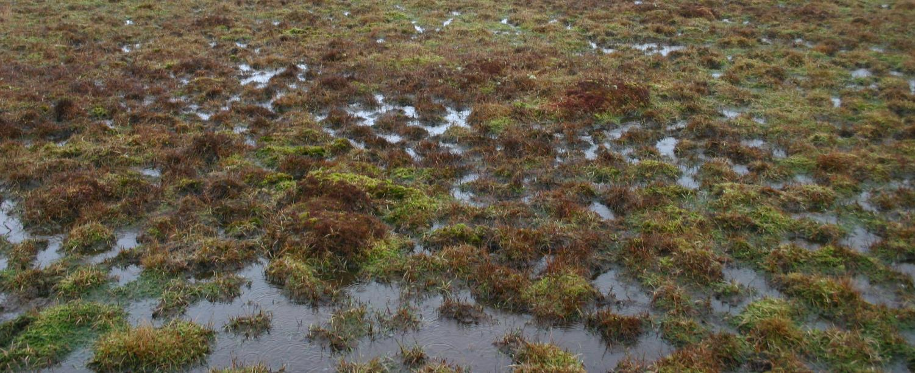
Pollen grains carried by the wind may land in lakes and on peat bogs, where they may become fossilised.
These are wet and acidic environments.

Slide 3
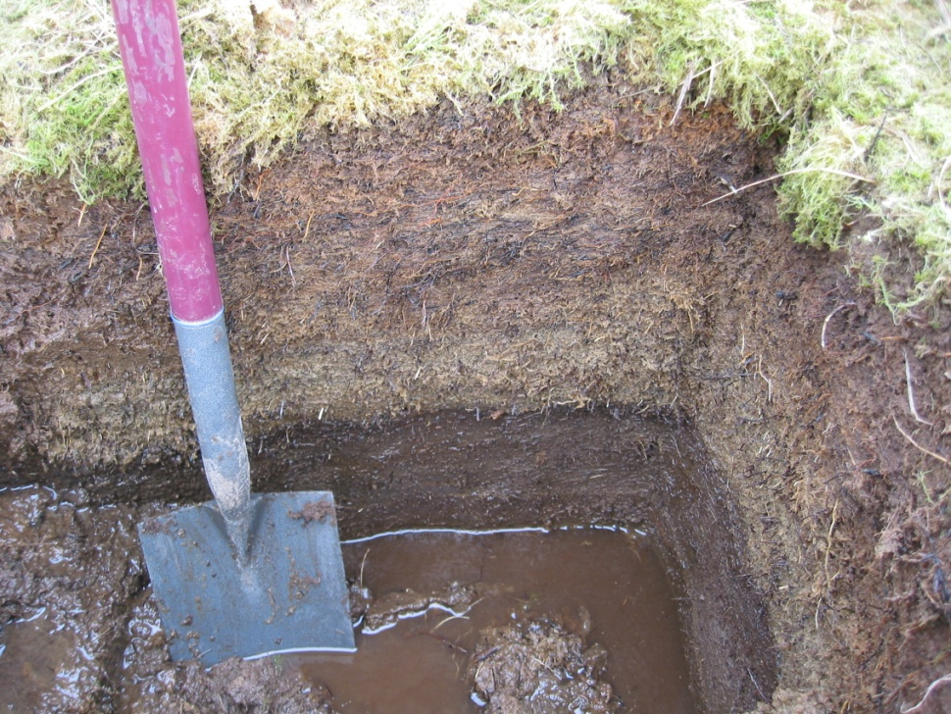
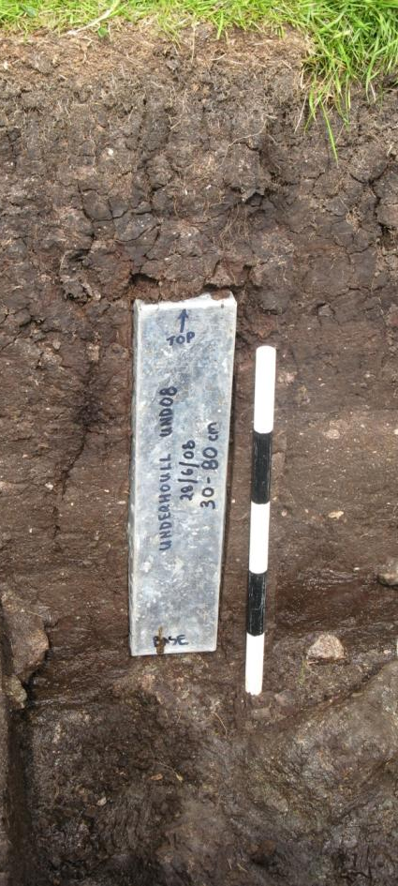
Samples can be collected by digging a soil pit.

Slide 4
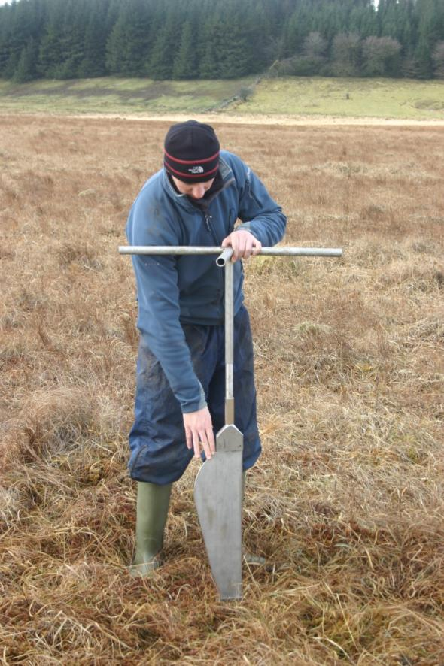
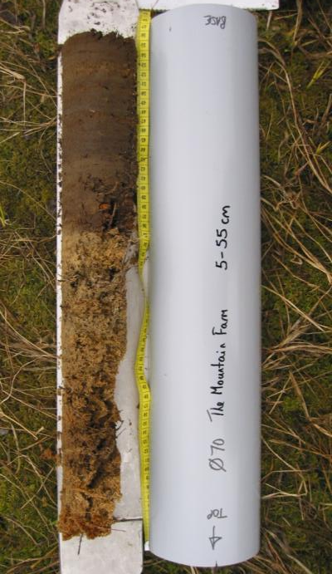
If the soil profile is very deep and peaty, we can use a ‘Russian corer’ (see left) to collect a sample.

Slide 5
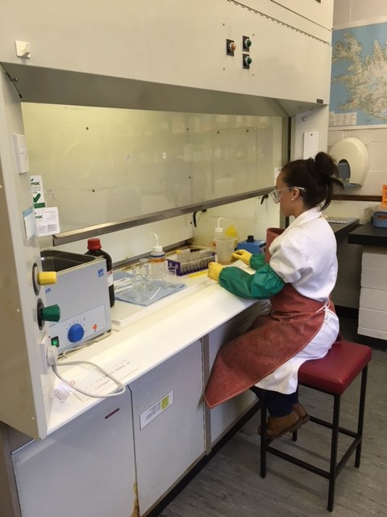
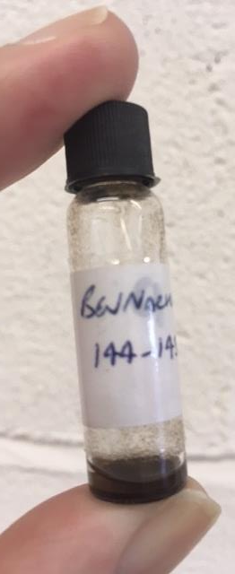
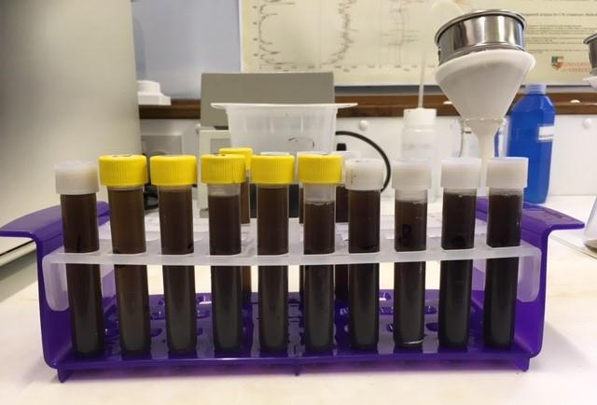
Pollen samples are prepared in a laboratory.

Slide 6
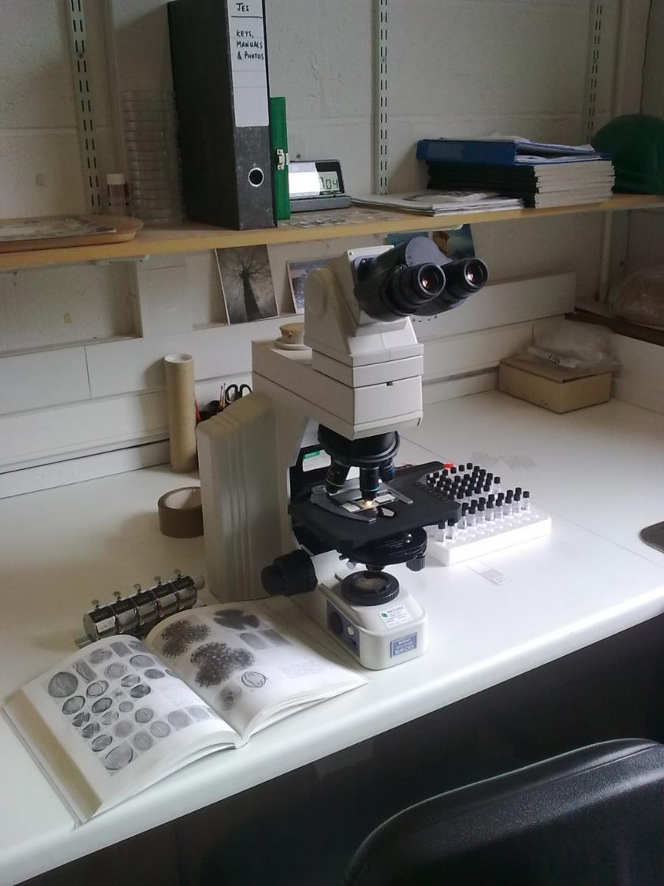
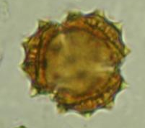
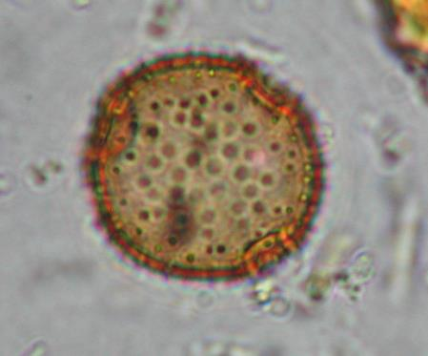
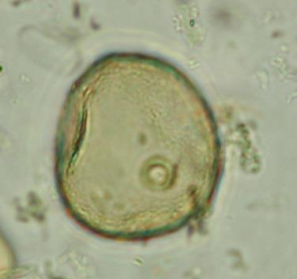
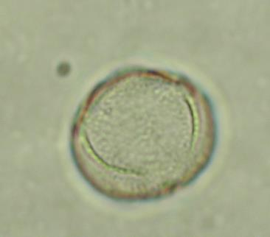
A microscope is used to identify the pollen grains.
Daisy
Harebell
Grass
Sorrel / dock

Slide 7
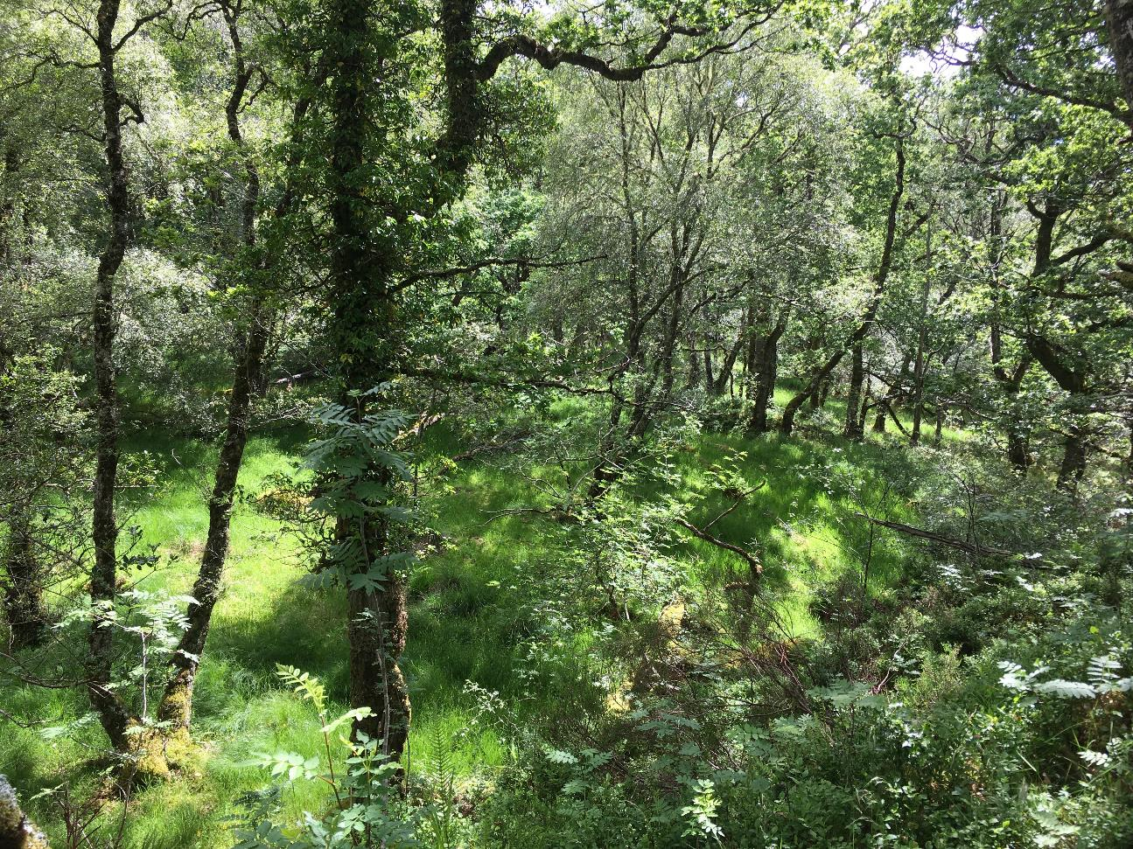
The pollen samples provide us with a ‘time machine’ to reconstruct the vegetation as it looked in the past.

Slide 8
Let’s investigate
Identify and count the different pollen grains as they move under the microscope.

Slide 9
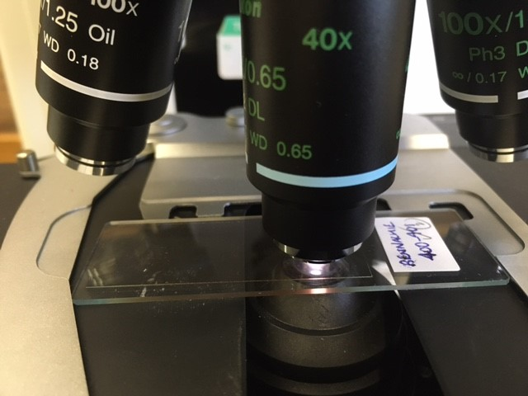

Slide 10
Analysis
Add up the numbers of pollen grains and plot a bar chart.
Reconstruction
Looking at your chart – the data – what do you think the landscape might have looked like in the past?
Draw the landscape as it appeared in the past.

Slide 11
Note for teachers
The next slide is a count sheet for the pollen grain counting activity. You can print off copies for your class.

Slide 12
Pollen count sheet
Name: _____________________________________________
Alder
Birch
Elm
Hazel
Heather
Grass
Oak
Scots Pine
Plantain
Sedge

